Slide 1

G2M insight for Cab investment case study
Virtual internship
21-March-2023

Slide 2
Problem statement
XYZ is a private equity firm in the US. Due to remarkable growth in the Cab Industry in the last few years and multiple key players in the market, it is planning for an investment in the Cab industry.
Objective: Provide specific insights to help XYZ firm in identifying the right company to make an investment.
The steps followed in this analysis are
Understanding the given data (Data collection)
Data preprocessing
Exploratory data analysis(EDA)
Finding the profit and number of rides for each cab

Slide 3
Data Exploration
The given four datasets are
Cab_Data.csv
City.csv
Customer_ID.csv
Transaction_ID.csv
The final dataset has 359392 observations and 14 features.
The time period of data is from 31/01/2016 to 31/12/2018.
After removing the outliers, the dataset is 353434.
Assumptions:
The outliers are removed using the interquartile range (IQR).
The profit column is created by the difference between the ‘price charged’ and the ‘cost of the trip’.
The profit made by the two companies is calculated.

Slide 4
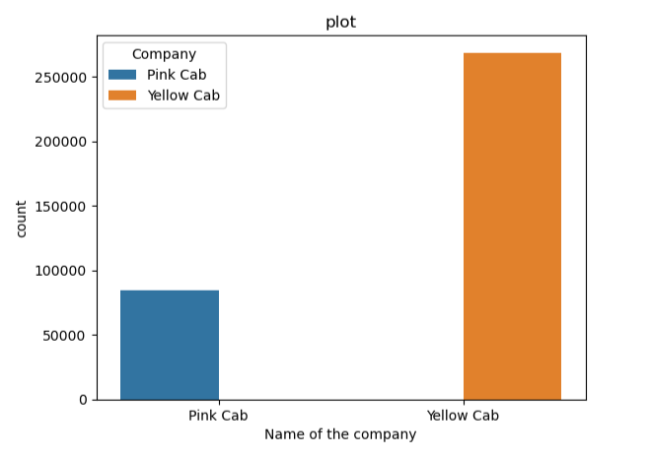
Profit Analysis
Cab Analysis
This plot is representing the count of people using the pink cab and yellow cab.
From this plot, we can say yellow cab users are more when compared to pink cab users.

Slide 5
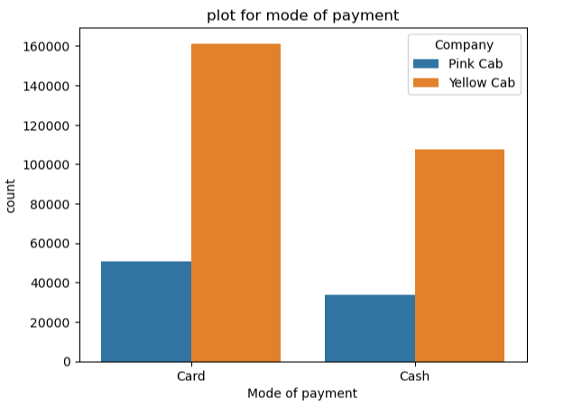
Mode of payment Analysis
Here this plot is showing the mode of payment of both companies.
From the plot, the card users in the yellow cab are more than the card users in the pink cab.
The mode of payment by both cab companies are compared here, to know about the mode of payment.

Slide 6
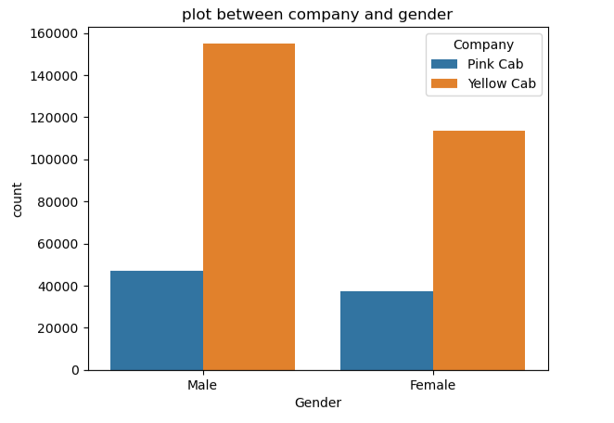
Gender Analysis
The male is using cab services more when compared to the female. Both females and males are using a yellow cabs more.

Slide 7
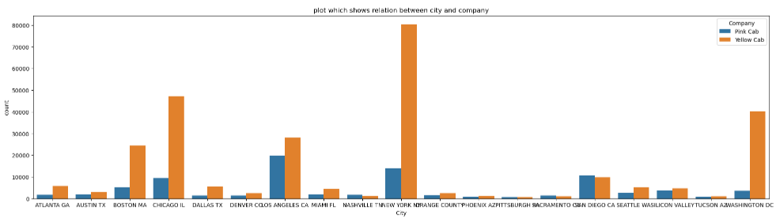
Cabs using in cities Analysis
The 3 cities are mainly using yellow cabs are New York, Chicago and Washington Dc.
Where the pink cabs are mostly used in cities like Los Angeles, New York and San diego.

Slide 8
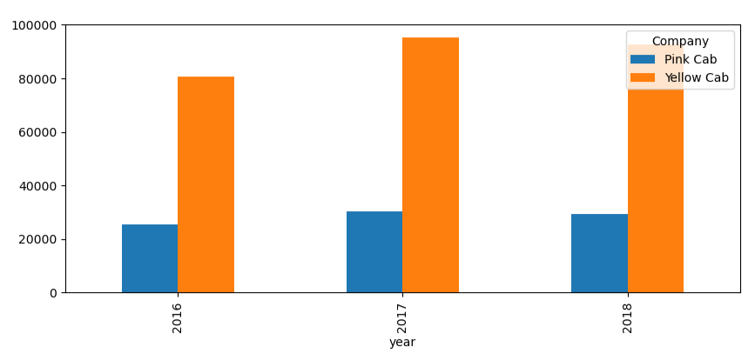
Yearly profit Analysis
The yearly analysis of yellow cabs is slightly low in 2018. The yearly analysis of pink cabs is the same. But there is slow growth in the pink cab industry.

Slide 9
Profit Analysis
The profit made by yellow cab is 87% and pink cab is 13%.
The profit per ride of the yellow cab is 147.07 and the pink cab is 62.48.
Yellow cabs higher customer base as compared to Pink cabs.

Slide 10
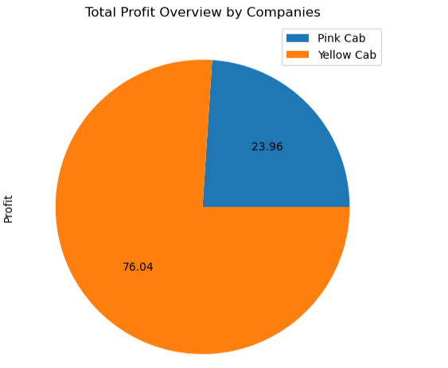
Total profit overview by both companies

Slide 11
Recommendations
The evaluation shows that Yellow cab performs better than Pink cab in several aspects:
Customer Reach: In 25 cities, Yellow cab has a higher customer reach than Pink cab, and it also covers other cab users better.
Customer Retention: Yellow cab retains customers who have taken at least 5 or 10 drives with the company better than Pink cab.
Age-wise Reach: Yellow cab has customers in all age groups, including the 60+ age group, and is equally popular among the 18-25 age group.
Average Profit per KM: Yellow cab's average profit per kilometre is almost three times that of Pink cab.
Income-wise Reach: While both cab companies are popular among high and medium-income groups, Yellow cab offers its services to all three income class groups (low, medium, and high) better than Pink cab.
Ride count and Profit Forecasting: Both companies are experiencing losses in profit and ride count. However, while Yellow cab’s projected profit loss is around 1.83%, Pink cab’s loss is 3.1%. The pink cab is facing a greater loss in profitability, even though its anticipated ride loss is lower than the Yellow cab.

Slide 12
Thank You

